Slide 1
Chord (P2P)
Evan Srock
Ethan Mahintorabi
Harvey Hartwell

Slide 2
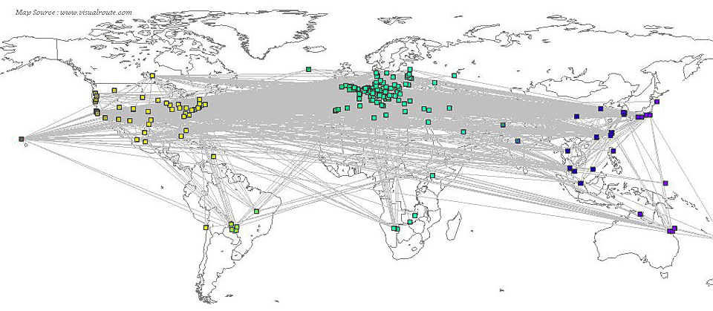
Topology

Slide 3
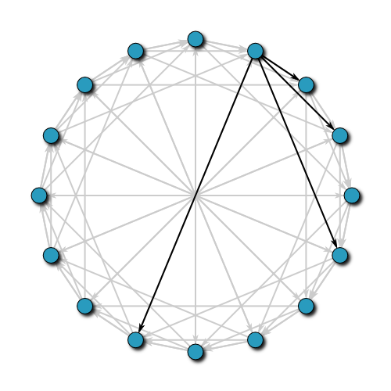
Chord Topology (Overlay Network)
Source 1

Slide 4
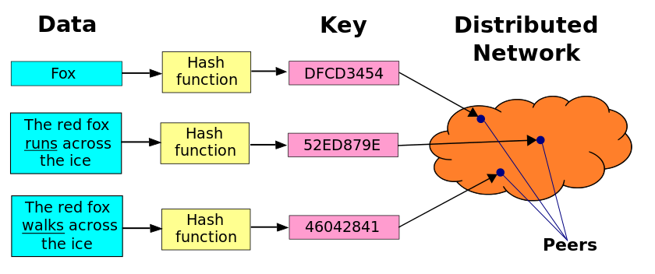
Overview
Distributed Hash Table
Decentralized
Distributed (1/n key space for each node)
Scalable (millions of nodes)
Key space determined by SHA-1
Size is 160 bits = 2¹⁶⁰ = 1.46*10⁴⁸
Nodes join and leave freely
Lookup(key)
Gets you the node responsible for that key
Source 3

Slide 5
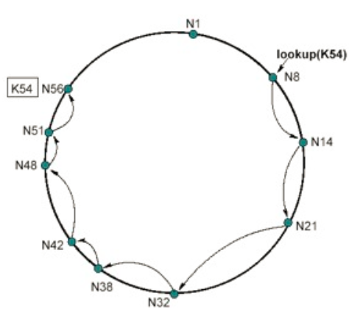
Lookup
Node.findSuccessor(key)
Node is responsible for
Key space before itself but before predecessor
Each node maintains
Successor
Predecessor
Unsuccessful lookups = Delay
Source 2

Slide 6
Fingers = Faster Lookup

Slide 7
Joining

Slide 8
Stabilization and Leaving

Slide 9
Efficiency

Slide 10
Compared to Others

Slide 11
Demonstration

Slide 12
Sources
https://en.wikipedia.org/wiki/Chord_(peer-to-peer)
http://zoo.cs.yale.edu/classes/cs722/2011/Jason_chord.pdf
https://en.wikipedia.org/wiki/Distributed_hash_table

